Slide 1
Data Visualization Project
Subject: 47451 Data Visualization
Name: Cara
Student ID: 10890021

Slide 2
Data Visualization Problem 1:
What is the problem you want to solve in data analysis?
What are the salary differences based on experience levels, employment types, or work modes…?
What is the dataset for data analysis?
data_science_salaries
What is the download link URL? (Please clearly marked the download URL link of your dataset)
https://www.kaggle.com/datasets/sazidthe1/data-science-salaries/data

Slide 3
Data Visualization Problem 1:
Which tool do you use to visualize the results of your data analysis?
Python
Tableau
What is the file name?
Python: 10890021_DataVisualization_Project.py
Tableau: 10890021_DataVisualization_Project.twbx

Slide 4
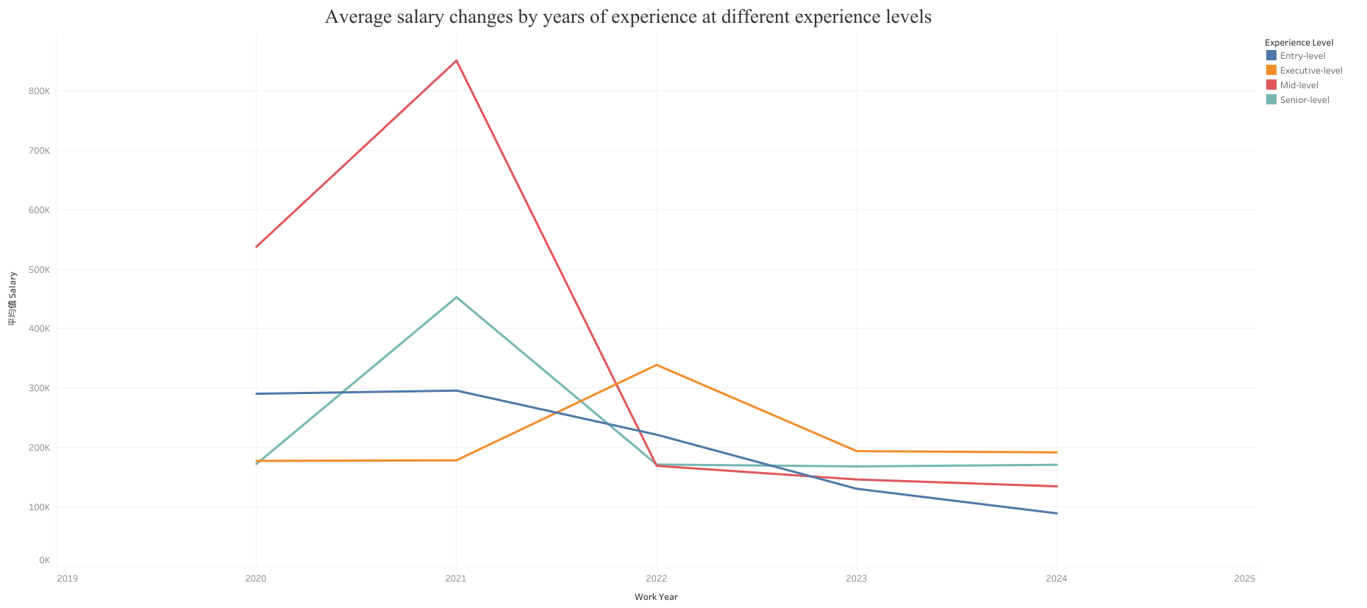
Tableau visualization charts

Slide 5
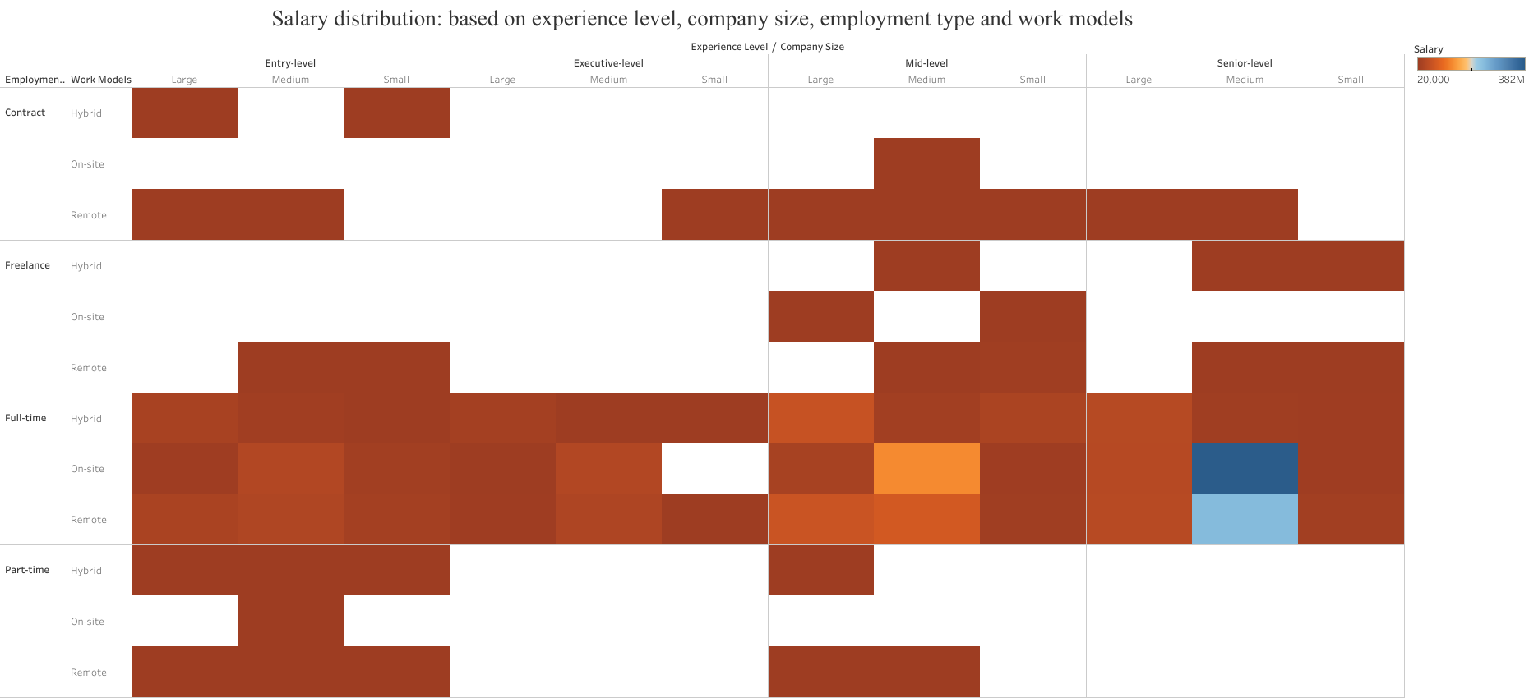
Tableau visualization charts
Classification in the next few dimensions
Experience level (Entry-level, Mid-level, Senior-level, Executive-level)
Company size (Large, Medium, Small)
Employment form (Contract, Freelance, Full-time, Part-time)
Working mode (Hybrid, On-site, Remote

Slide 6
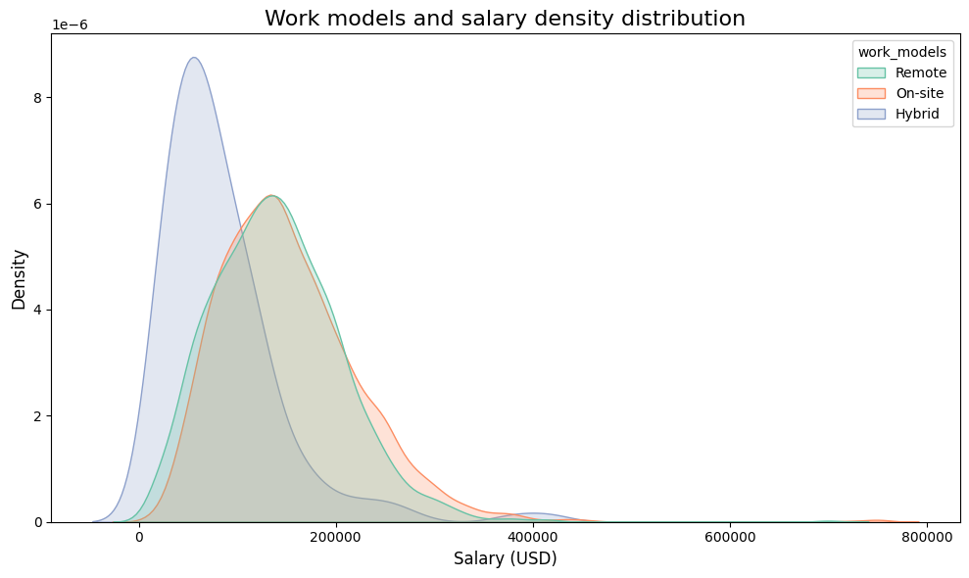
Python visualization charts

Slide 7
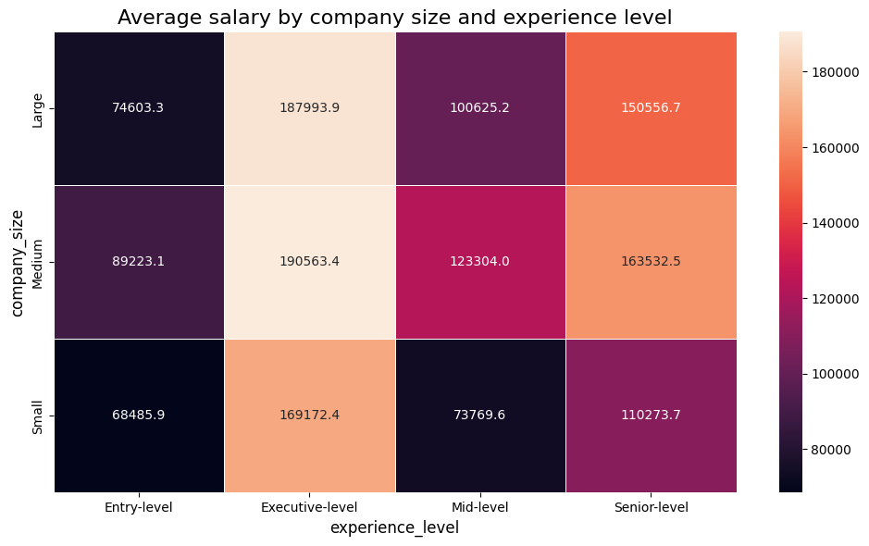
Python visualization charts
Horizontal axis (experience_level):
Entry-level: Junior.
Mid-level: Intermediate.
Senior-level: senior.
Executive-level: executive level.
Vertical axis (company_size):
Small: small company.
Medium: Medium-sized company.
Large: Large company.

Slide 8
Conclusion
What is the conclusion of data analysis insights obtained through visual charts?
The importance of experience: Experience level is the core factor in determining salary. Regardless of company size or work mode, the salary of employees with high experience levels is significantly higher than that of other levels.
Shifts in work models: Remote and hybrid work models are becoming more attractive for high-paying positions, while the salary attractiveness of on-site work is decreasing.
The impact of company size: Medium-sized companies have stable and competitive salaries, large companies are more suitable for highly experienced employees, and small companies are a springboard for junior employees.
Full-time vs. other job types: Full-time jobs have the widest salary range, other types (e.g., freelance) are competitive in specific situations (e.g., remote, high experience)

